Slide 1
Unit 2 – Requirement Engineering

Slide 2
Topics covered
Concept of Requirement Engineering
Requirement elicitation
Requirements management in Agile
Requirement document/specification
Types of requirements
Goal-Oriented RE and KAOS

Slide 3
Concept of
Requirement Engineering

Slide 4
Cool Quote
“The most difficult part of requirements gathering is not the act of recording what the users want; it is the exploratory, developmental activity of helping users figure out what they want.”
--Steve McConnell

Slide 5
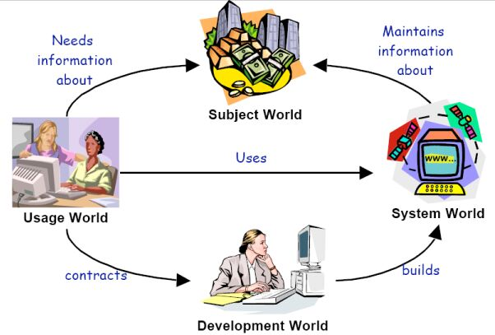

The four worlds
Adapted from Loucopoulos & Karakostas, 1995, p73
Notes:
Subject World 主题世界
the subject matter of the information system
由信息系统的主题事物组成的世界
e.g., customers, accounts, transactions for a bank information system
如： 顾客、账号，银行信息系统中的各类交易
Usage World 应用世界
the environment within which the planned system will operate
计划中的系统未来的操作环境
e.g., people, such as managers, clerks, customers; also business processes such as handling a withdrawal, a deposit of foreign currency,...
如： 人及企业流程。人包括：经理、职员、顾客；企业流程包括：取款交易过程、外币存款交易过程， 等
System World 系统世界
what the system does within its operational environment
系统在其操作环境下所进行的操作
what information it contains and what functions it performs
系统内含有何种信息，完成哪些功能
e.g., system records all transactions in a database, reports on transactions for a particular account, gives account balance,...
例如：系统将所有交易记录在数据库中，对指定账号的交易进行报告，给出账户余额
Development World 开发世界
the development process, team, schedule, required qualities (security, performance,…) etc.
开发的过程、人员、进度、安全、性能等质量要求， 等等
e.g., system to be delivered in 12 months, fully tested to MCDC standard, etc.
系统要在12个月内交付使用，应按MCDC标准完全测试通过， 等
MCDC - Modified Condition Decision Coverage testing

Slide 6

Starting Points
Stakeholders
  Importance of Customer Links
  Who are the stakeholders?
Boundaries
  How do you scope the problem?
Goals and Scenarios
  A useful way to organize initial collection of information
Feasibility
  How to conduct a feasibility study
  How to choose which project to pursue
Risk
  Continuous Risk Management
  Identifying risks through hazard and fault analysis

Slide 7
Stakeholders
Stakeholder analysis
  Identify all the people who must be consulted during information acquisition
  Look for stakeholders associated with each of the four worlds
Example stakeholders
  Users - concerned with the features and functionality of the new system
  Designers - want to build a perfect system, or reuse existing code
  Systems analysts - want to “get the requirements right”
  Training and user support staff - want to make sure the new system is usable and manageable
  Business analysts - want to make sure “we are doing better than the competition”
  Technical authors - will prepare user manuals and other documentation for the new system
  The project manager - wants to complete the project on time, within budget, with all objectives met.
  “the customer” - whoever it is that pays for the new system!
Notes:
Others： Buyer, end user, quality assurer, CEO, steering committee member, regions and countries, product development manager, marketer or salesperson, requirements engineer, lawyer or regulator.

Slide 8
Phases of Requirements
perceived
need
Elicitation
Analysis
Specification
Management
Validation
requirements
Very expensive
design
code
test
integrate

Slide 9
Elicitation
Proactively working with stakeholders to discover their needs, identify and negotiate potential conflicts, and establish a clear scope and boundaries for the project.
Understanding the Problem and Its Domain.
Making the business case
  Current trends are that organizations are no longer willing to invest in IT projects unless those projects return clear value to the business

Slide 10

Elicitation (cont)
Elicitation techniques
  Collaborative sessions
  Interviewing techniques
  Questionnaires
  Ethnography
  Prototyping
  Documentation
  Modeling
  Roleplaying
  Checklists of NFRs (non-functional requirements)
Conflict Identification and Negotiation

Slide 11
Analysis
A deeper understanding of the product and its interactions, identify requirements, define high-level architectural design, allocating req to architectural components, and identify additional conflicts that merge through considering architectural implementations and negotiating agreements between stakeholders.
Conceptual Modeling
    ML is very well known.
    IEEE Std 1320.1, IDEF0 for functional modeling and IEEE Std 1320.2 IDEF1 X97 for information modeling.

Slide 12
Specification
Documents that capture the system and software req. in order to support their systematic review, evaluation, and approval. Document that describes the system to be developed in a format that can be reviewed, evaluated and approved in a systematic way.
Qualities of an Individual Requirement
  Concise
  Correct
  Non-ambiguous
  Feasible
  Verifiable
Qualities of the Set of Requirements
  Realistic
  Concise
  Complete
  Consistent

Slide 13
Validation
Goes through the other four activities. Ensure the system meets stakeholders requirements through activities such as formal and informal reviews
Types of validation
  Reviews
  Prototyping
  Model validation
  Acceptance Tests

Slide 14
Management
Starts from the moment the first req is elicited and ends only when the system is finally decommissioned. Requirement management includes software configuration management, traceability, impact analysis, and version control.
Requirements traceability
  Ability to describe and follow the life of a requirement, in both a forward and backward direction.
Change Requests
  Managed systematically.
Requirement attributes

Slide 15
Conclusion
Traditional Methods
Agile Methods

Slide 16
Requirements Management in Agile
Notes:
<*s*o*u*r*c*e*>*9*1*8*c*1*-*3*-*1*<*/*s*o*u*r*c*e*>
Jogger text: Requirements Management
Direction: Left then right
Section starts: Day 1 at 3:15pm
Instructor notes:

Slide 17
Agile methods and requirements
Many agile methods argue that producing a requirements document is a waste of time as requirements change so quickly.
The document is therefore always out of date.
Methods such as XP use incremental requirements engineering and express requirements as ‘user stories’.
This is practical for business systems but problematic for systems that require a lot of pre-delivery analysis (e.g. critical systems) or systems developed by several teams.

Slide 18
Requirements Management
At its simplest, software development is about creating product that meets its users’ needs
  In Scrum terms, turning backlog into increments of functionality
    Assuming needs are expressed as requirements
Requirements issues rank top in most surveys of software project failures
  For example, the CHAOS* report
    Incomplete requirements (13.1 %)
    Lack of user involvement (12.4 %)
    Unrealistic expectations (9.9 %)
    Changing requirements and specifications (8.7 %)
    Didn’t need the project any longer (7.5 %)
*The CHAOS Report. The Standish Group, 1995-2010.
Notes:
<*s*o*u*r*c*e*>*9*1*8*c*1*-*3*-*4*<*/*s*o*u*r*c*e*>

Slide 19
Agile Requirements Management
Traditional approaches rely on adding levels of management control
  Produces reams of requirements documentation
  Most of the work is done up front
    And often needs to be completed before development work can proceed
But for complex systems, it is impossible to define all requirements up front
  Not least because they are liable to change
Agile approaches tend towards doing “just enough” up-front requirements
  Where “enough” means “enough to start development”
  And then continuously evolving them
Notes:
<*s*o*u*r*c*e*>*9*1*8*c*1*-*3*-*5*<*/*s*o*u*r*c*e*>

Slide 20


Recap: The Sprint Planning Meeting
Sprint Planning Meeting
Part One
Sprint Planning Meeting
Part Two
Product
Backlog
What?
How much can
be done
How?
Sprint Goal
What features are highest
priority
Product Owner
Feature
Team
Sprint Backlog
Notes:
<*s*o*u*r*c*e*>*9*1*8*c*1*-*3*-*6*<*/*s*o*u*r*c*e*>

Slide 21
User Stories
A common Agile technique is user stories
  Derived from Extreme Programming (XP)
    A popular Agile software development method
A user story is a simple description of some requirement written from a user’s viewpoint
  Usually on an index card, typically 6" x 4"
  Not a completely defined requirement
    XP says, “There are no (system) requirements to start with”
  A “reference point for a conversation”
    Detailed requirements will evolve through interaction between the customer and the developers
The aim is to shift toward having face-to-face conversations about requirements and technical issues
  Rather than to manage documentation about them
Notes:
<*s*o*u*r*c*e*>*9*1*8*c*1*-*3*-*8*<*/*s*o*u*r*c*e*>
Jogger text: User Stories
Direction: Left
Instructor notes:

Slide 22
User Stories: An Example
User Story #7 View Shopping Cart Contents
As a registered customer, I want to be able to view all items currently in my Shopping Cart together with their prices, so that I can see how much money I am spending.
Priority: Estimate:
There is no standard format for writing user stories
The above example is typical:
  As a <role> I want <feature> so that <goal>
Often, the back of the card describes the acceptance test for the requirement
Notes:
<*s*o*u*r*c*e*>*9*1*8*c*1*-*3*-*9*<*/*s*o*u*r*c*e*>
Jogger text: User Stories: An Example
Direction: Right
Instructor notes:
Elaboration: User Stories are often written on 6”x 4” index cards
‘Priority’ is a ranking based on business value of the features – determined by PO
‘Estimate’ is an holistic measure of effort/complexity of construction – made by the Feature Team

Slide 23

The Life Cycle of a User Story
Idea
User Story
~~~~~~~~~~~~~~~~~~~~~~~~~
Implemented Product
Conversation
Tests
Notes:
<*s*o*u*r*c*e*>*9*1*8*c*1*-*3*-*1*0*<*/*s*o*u*r*c*e*>
Jogger text: The Life Cycle of a User Story
Direction: Left
Instructor notes:
Elaboration: This graphic (adapted from Agile Coaching by Davies and Sedley) focuses on the essential role of user stories in driving conversation. The point that this leaves open the level of documentation. You might add Business Service Requirements documents and System Requirements around the edges – the first as an ‘input’ to the lightbulb and the second as an output from the chrysalis just to make that point – of course the actual production of these documents would not normally be laid upon the shoulders of the Feature Team.

Slide 24
The Definition of “Done”
How does the Feature Team know when it has met a requirement?
Scrum requires that every increment be “potentially shippable”
  The Product Owner may decide to deploy it immediately
    Even if the Sprint is not at the end of a scheduled release
  This means gaining agreement about what it means to be “done”
Different people have different perspectives
  A programmer might believe “done” is when the code is complete
  A tester is “done” when unit and integration testing is done
  A customer might regard “done” as
    Installation, deployment of the system
    Together with user documentation
    And (perhaps) user training
In Scrum, “done” is an agreement between the Product Owner and the Feature Team
  Minimally, the acceptance test for a story
  At this level, it will vary from user story to user story
Notes:
<*s*o*u*r*c*e*>*9*1*8*c*1*-*3*-*1*4*<*/*s*o*u*r*c*e*>

Slide 25
Requirement specification

Slide 26
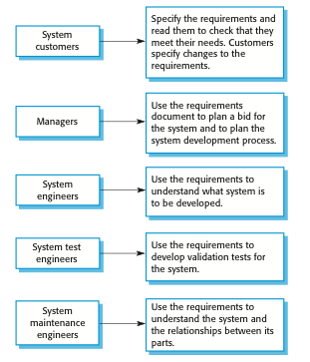
Users of a requirements document

Slide 27
The structure of a requirements document
Chapter | Description
Preface | This should define the expected readership of the document and describe its version history, including a rationale for the creation of a new version and a summary of the changes made in each version.
Introduction | This should describe the need for the system. It should briefly describe the system’s functions and explain how it will work with other systems. It should also describe how the system fits into the overall business or strategic objectives of the organization commissioning the software.
Glossary | This should define the technical terms used in the document. You should not make assumptions about the experience or expertise of the reader.
User requirements definition | Here, you describe the services provided for the user. The nonfunctional system requirements should also be described in this section. This description may use natural language, diagrams, or other notations that are understandable to customers. Product and process standards that must be followed should be specified.
System architecture | This chapter should present a high-level overview of the anticipated system architecture, showing the distribution of functions across system modules. Architectural components that are reused should be highlighted.
Chapter 4 Requirements engineering

Slide 28
The structure of a requirements document
Chapter | Description
System requirements specification | This should describe the functional and nonfunctional requirements in more detail. If necessary, further detail may also be added to the nonfunctional requirements. Interfaces to other systems may be defined.
System models | This might include graphical system models showing the relationships between the system components and the system and its environment. Examples of possible models are object models, data-flow models, or semantic data models.
System evolution | This should describe the fundamental assumptions on which the system is based, and any anticipated changes due to hardware evolution, changing user needs, and so on. This section is useful for system designers as it may help them avoid design decisions that would constrain likely future changes to the system.
Appendices | These should provide detailed, specific information that is related to the application being developed; for example, hardware and database descriptions. Hardware requirements define the minimal and optimal configurations for the system. Database requirements define the logical organization of the data used by the system and the relationships between data.
Index | Several indexes to the document may be included. As well as a normal alphabetic index, there may be an index of diagrams, an index of functions, and so on.
Chapter 4 Requirements engineering

Slide 29
Ways of writing a system requirements specification
Notation | Description
Natural language | The requirements are written using numbered sentences in natural language. Each sentence should express one requirement.
Structured natural language | The requirements are written in natural language on a standard form or template. Each field provides information about an aspect of the requirement.
Design description languages | This approach uses a language like a programming language, but with more abstract features to specify the requirements by defining an operational model of the system. This approach is now rarely used although it can be useful for interface specifications.
Graphical notations | Graphical models, supplemented by text annotations, are used to define the functional requirements for the system; UML use case and sequence diagrams are commonly used.
Mathematical specifications | These notations are based on mathematical concepts such as finite-state machines or sets. Although these unambiguous specifications can reduce the ambiguity in a requirements document, most customers don’t understand a formal specification. They cannot check that it represents what they want and are reluctant to accept it as a system contract
Chapter 4 Requirements engineering

Slide 30
Use cases
Use-cases are a scenario based technique in the UML which identify the actors in an interaction and which describe the interaction itself.
A set of use cases should describe all possible interactions with the system.
High-level graphical model supplemented by more detailed tabular description.
Sequence diagrams may be used to add detail to use-cases by showing the sequence of event processing in the system.

Slide 31
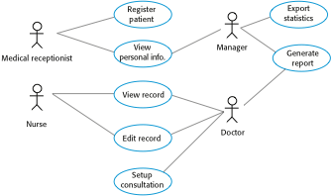
Use cases for the MHC-PMS

Slide 32
UML diagrams in different developmental stages
Activity
State
Class
(Complex)
Class
(Simple)
Requirement
Use case
Object
Sequence
Collaboration
Requirement stage
Analysis stage
Design stage

Slide 33
Types of Requirement

Slide 34
Types of requirement
User requirements
  Statements in natural language plus diagrams of the services the system provides and its operational constraints. Written for customers.
System requirements
  A structured document setting out detailed descriptions of the system’s functions, services and operational constraints. Defines what should be implemented so may be part of a contract between client and contractor.

Slide 35
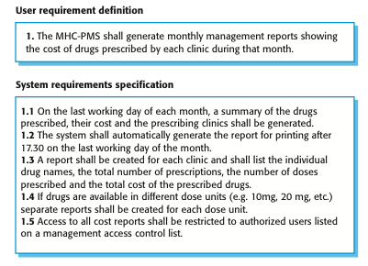
User and system requirements

Slide 36
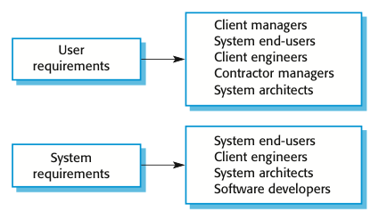
Readers of different types of requirements specification

Slide 37
Functional and non-functional requirements
Functional requirements
  Statements of services the system should provide, how the system should react to particular inputs and how the system should behave in particular situations.
  May state what the system should not do.
Non-functional requirements
  Constraints on the services or functions offered by the system such as timing constraints, constraints on the development process, standards, etc.
  Often apply to the system as a whole rather than individual features or services.

Slide 38
Functional requirements
Describe functionality or system services.
Depend on the type of software, expected users and the type of system where the software is used.
Functional user requirements may be high-level statements of what the system should do.
Functional system requirements should describe the system services in detail.

Slide 39
Functional requirements for the MHC-PMS
A user shall be able to search the appointments lists for all clinics.
The system shall generate each day, for each clinic, a list of patients who are expected to attend appointments that day.
Each staff member using the system shall be uniquely identified by his or her 8-digit employee number.

Slide 40
Requirements imprecision
Problems arise when requirements are not precisely stated.
Ambiguous requirements may be interpreted in different ways by developers and users.
Consider the term ‘search’ in requirement 1
  User intention – search for a patient name across all appointments in all clinics;
  Developer interpretation – search for a patient name in an individual clinic. User chooses clinic then search.

Slide 41
Requirements completeness and consistency
In principle, requirements should be both complete and consistent.
Complete
  They should include descriptions of all facilities required.
Consistent
  There should be no conflicts or contradictions in the descriptions of the system facilities.
In practice, it is impossible to produce a complete and consistent requirements document.

Slide 42
Non-functional requirements
These define system properties and constraints e.g. reliability, response time and storage requirements. Constraints are I/O device capability, system representations, etc.
Process requirements may also be specified mandating a particular IDE, programming language or development method.
Non-functional requirements may be more critical than functional requirements. If these are not met, the system may be useless.

Slide 43
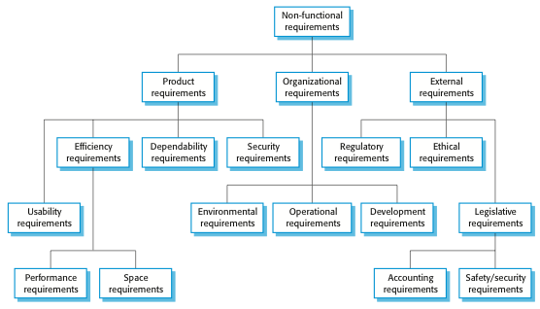
Types of nonfunctional requirement

Slide 44
Non-functional requirements implementation
Non-functional requirements may affect the overall architecture of a system rather than the individual components.
  For example, to ensure that performance requirements are met, you may have to organize the system to minimize communications between components.
A single non-functional requirement, such as a security requirement, may generate a number of related functional requirements that define system services that are required.
  It may also generate requirements that restrict existing requirements.

Slide 45
Non-functional classifications
Product requirements
  Requirements which specify that the delivered product must behave in a particular way e.g. execution speed, reliability, etc.
Organisational requirements
  Requirements which are a consequence of organisational policies and procedures e.g. process standards used, implementation requirements, etc.
External requirements
  Requirements which arise from factors which are external to the system and its development process e.g. interoperability requirements, legislative requirements, etc.

Slide 46
Examples of nonfunctional requirements in the MHC-PMS
Product requirement The MHC-PMS shall be available to all clinics during normal working hours (Mon–Fri, 0830–17.30). Downtime within normal working hours shall not exceed five seconds in any one day. Organizational requirement Users of the MHC-PMS system shall authenticate themselves using their health authority identity card. External requirement The system shall implement patient privacy provisions as set out in HStan-03-2006-priv.

Slide 47
Usability requirements
The system should be easy to use by medical staff and should be organized in such a way that user errors are minimized. (Goal)
Medical staff shall be able to use all the system functions after four hours of training. After this training, the average number of errors made by experienced users shall not exceed two per hour of system use. (Testable non-functional requirement)

Slide 48
Metrics for specifying nonfunctional requirements
Property | Measure
Speed | Processed transactions/second User/event response time Screen refresh time
Size | Mbytes Number of ROM chips
Ease of use | Training time Number of help frames
Reliability | Mean time to failure Probability of unavailability Rate of failure occurrence Availability
Robustness | Time to restart after failure Percentage of events causing failure Probability of data corruption on failure
Portability | Percentage of target dependent statements Number of target systems

Slide 49
Goal-Oriented RE and KAOS

Slide 50
Goals and requirements
Goal
  A general intention of the user such as ease of use.
Goals are helpful to developers as they convey the intentions of the system users.
Goals are desired system properties that have been expressed by some stakeholders
Verifiable non-functional requirement
  A statement using some measure that can be objectively tested.

Slide 51
Goal-Directed Requirements
Acquisition (KAOS)
(Organizational) goals lead to requirements.
Goals justify and explain requirements which are not necessarily comprehensible by stakeholders.
Goals can be used to assign responsibilities to agents so that prescribed constraints can be met.
Goals provide basic information for detecting and resolving conflicts that arise from multiple viewpoints

Slide 52
The KAOS Modeling Philosophy
Modeling a social setting involves a variety of concepts, including Goals, Agents, Concerned Objects, Actions, Constraints and Responsibilities.
Goals lead to assignments of responsibilities and designs of actions and artifacts
Use a metamodel to support reuse of generic domain modeling patterns [Dardenne93]
For example, the library domain is an instance of the “resource allocation” meta-domain, which also covers car/room/dwelling rental and is similar to airline/hotel reservation, class registration etc.

Slide 53
The KAOS Acquisition Process
Identify Goals, and their Concerned Objects.
Identify potential Agents and their Capabilities.
Operationalize Goals into Constraints.
Refine Objects and Actions.
Derive strengthened Objects and Actions to Ensure
Constraints.
Identify alternative Responsibilities.
Assign Actions to responsible Agents.
All this could be just as useful to someone doing
organizational design, rather than software development!

Slide 54
Four KAOS models :
Goal model
Responsability model
Operation model
Object model

Slide 55
KAOS
KAOS, is a goal-oriented software requirements capturing approach in requirements engineering.
It is a specific Goal modeling method; another is i*. It allows for requirements to be calculated from goal diagrams.
KAOS stands for Knowledge Acquisition in automated specification or Keep All Objectives Satisfied.
RE Tool Downloadble: http://www.utdallas.edu/~supakkul/tools/RE-Tools/creating-kaos.html

Slide 56
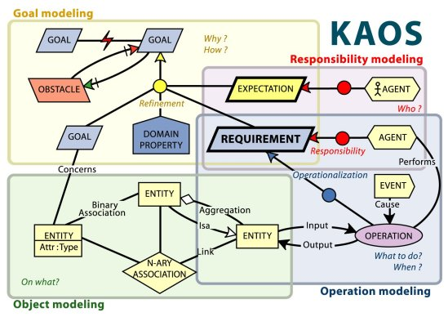
A taste of KAOS

Slide 57
Goal model
Clear distinction between two low-level types of goals:
Requirements, to be achieved by a software agent,
Expectations, to be achieved by an agent which is part of the system environment.
Conflicts (and more generally obstacles that prevent goals to be achieved) must be identified as soon as possible.

Slide 58
Goal & Responsibility model
Graphical Conventions
Goal
(blue)
(yellow)
goal refinement
Requirement
(blue)
goals conflict
Expectation
(yellow)
(red)
responsibility
Agent
(pink)
assignment
Domain property

Slide 59
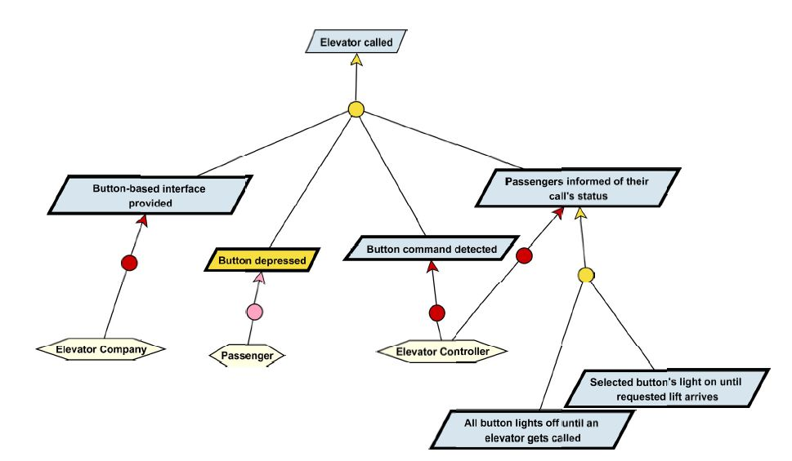
« Elevator called » goal
Goal model

Slide 60
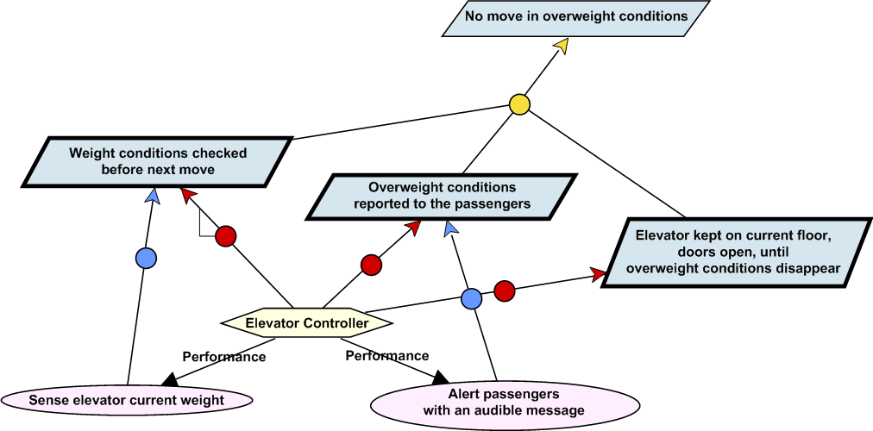
« Elevator overweight» goal
Goal model

Slide 61
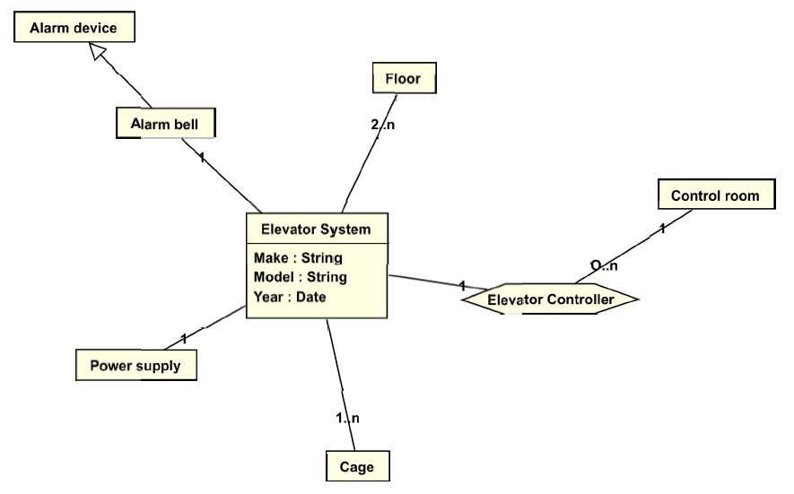
Object model
Object « Elevator system »:

Slide 62
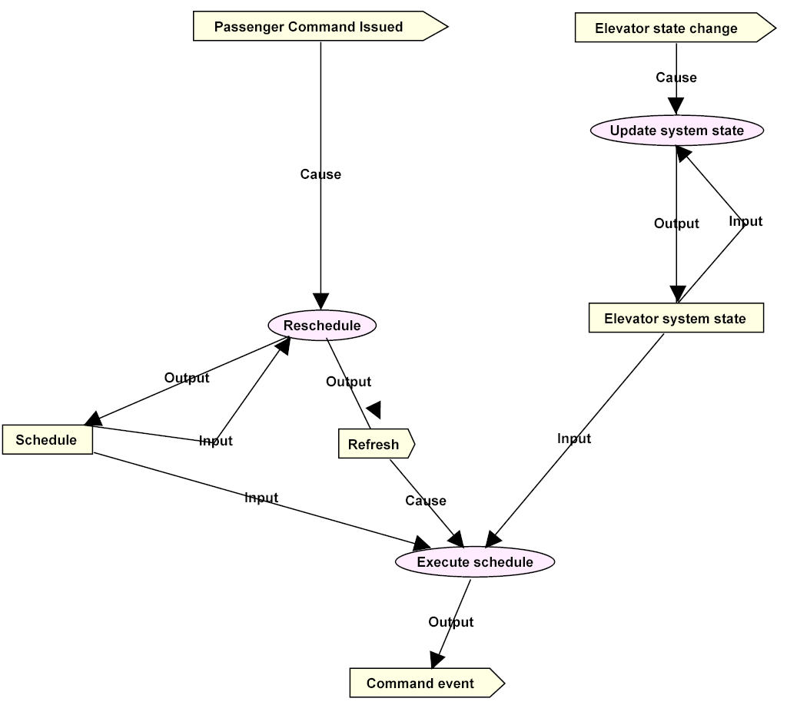
Operation model
Process
« Elevator control »

Slide 63
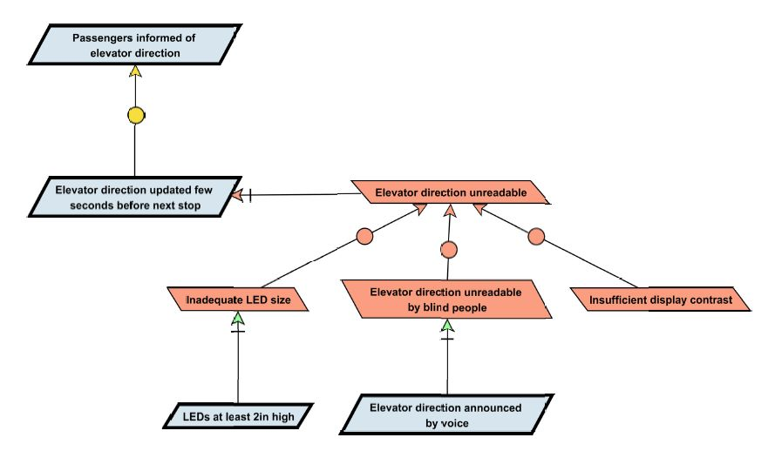
Obstacles
Obstacle resolution for « Passengers informed of elevator direction »:
(Resolve)

Slide 64
Contact Details
Lecturer: Xiaodong Liu
Email: x.liu@napier.ac.uk
Office: C55
Phone: 455 2747

Slide 65
Reference
Ian Sommerville, Software Engineering, 10th Edition, Addison Wesley, 2015.
Axel van Lamsweerde, Requirements Engineering: From System Goals to UML Models to Software Specifications, Wiley, 2009
Lin Liu, Requirements and System Modelling, Tsinghua University, 2015.
A KAOS Tutorial, Respect-IT, 2007.
Sam Supakkul and Lawrence Chung, the RE-Tools: A multi-national requirements modelling toolkit, IEEE RE conference, 2012

